Slide 1
LangChain Chat with Your Data: SFBU Customer Support System - text
Savitha Shree M (19981)

Slide 2
TABLE OF CONTENTS
INTRODUCTION
DESIGN
IMPLEMENTATION
SAMPLE OUTPUT
CONCLUSION

Slide 3
INTRODUCTION
This project presents a comprehensive workflow for implementing a Retrieval Augmented Generation (RAG) system, streamlining document processing and user interaction.
It begins with document loading and VectorDB creation, establishing a solid foundation for subsequent operations. Through similarity search techniques, relevant document chunks are efficiently selected, optimizing content retrieval.
Additionally, the system incorporates memory management and conversational context preservation, ensuring seamless interaction with the document-based chatbot.
Finally, the interface is adapted to a web-based platform, enhancing accessibility and user experience.

Slide 4
DESIGN
It is built in Python Programming language and Flask framework to implement the web based application.
gpt-3.5-turbo model is used for text completion.
The major modules involved are:
PyPDFLoader is used to load documents
It uses Langchain’s memory and chain modules to implement memory management
PromptTemplate to handle the chain of prompts.

Slide 5
DESIGN
The major steps involved are:
Handling text generation, translation
Document Loading and VectorDB creation.
Implement memory management and contextual text preservation
Putting everything together

Slide 6
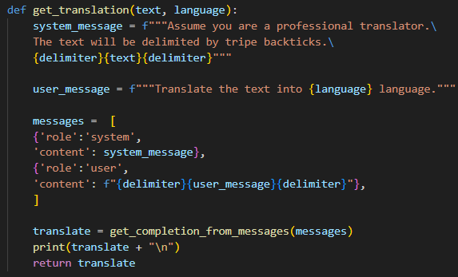
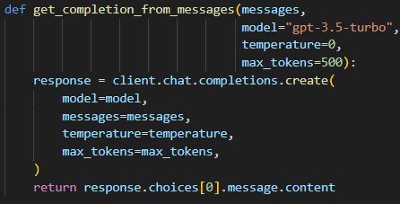
IMPLEMENTATION
STEP 1 - Handling text generation, translation
The text completion APIs are used to answer the questions. It is also handled to translate the answer in the needed language.

Slide 7
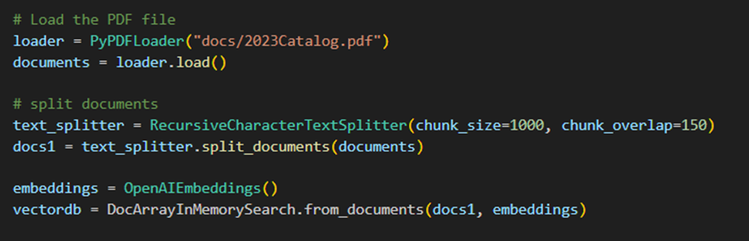
IMPLEMENTATION
STEP 2 - Document Loading and VectorDB creation.
The PDF file is loaded and split into smaller chunks. These chunks are then embedded and stored in the multi-dimensional vector store.

Slide 8
IMPLEMENTATION - OpenAI TTS
STEP 3 - Implement memory management and contextual text preservation.
Since it is a customer support system, previous conversational need to be saved in memory and displayed as a conversation. For this, we use ConversationBufferMemory and ConversationalRetrievalChain.
It has several parameters like how many conversations must be saved, input_key, output_key, etc..

Slide 9
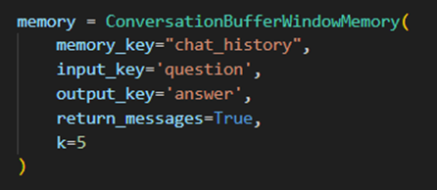
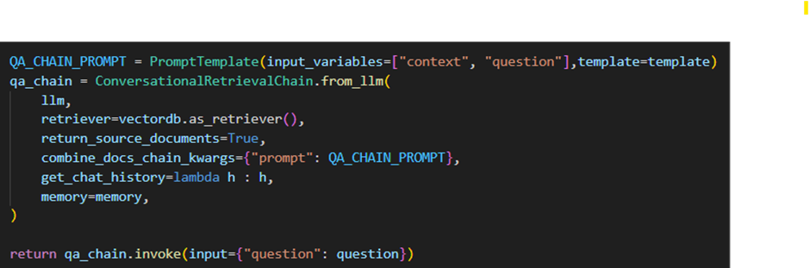
IMPLEMENTATION - OpenAI TTS
STEP 3 - Implement memory management and contextual text preservation.

Slide 10
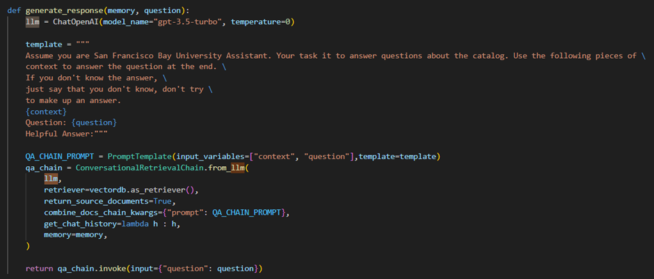
IMPLEMENTATION - OpenAI TTS
STEP 4 - Combining everything together

Slide 11
CONCLUSION
GITHUB LINK:
https://github.com/savithashreem07/Langchain/tree/main/Customer%20Support%20System
REFERENCES:
https://learn.deeplearning.ai/courses/langchain-chat-with-your-data/lesson/2/document-loading

